Slide 1
BizConnect Networking Reception
November 10, 2010

Slide 2
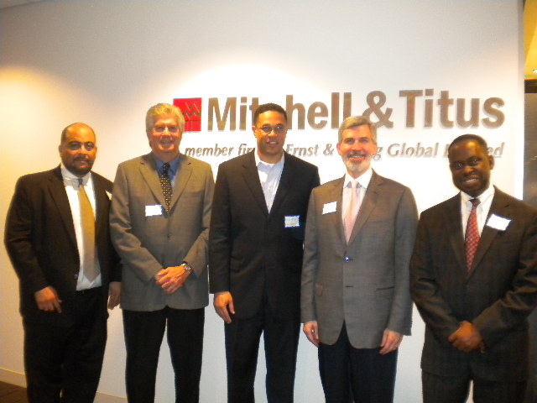
Notes:
Stephen Dillard, Jon Rutenberg (Computer Consultants Corporation), Rick Weedon (VP, BizConnect), William Spang, Winston Jones

Slide 3
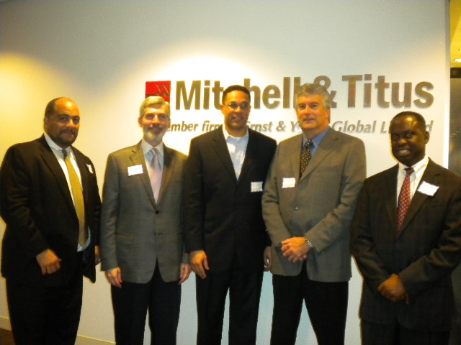

Slide 4
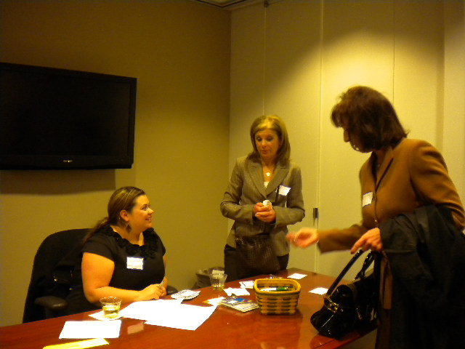

Slide 5
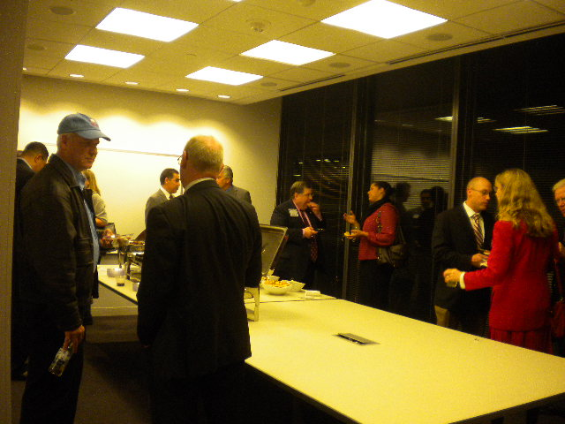

Slide 6
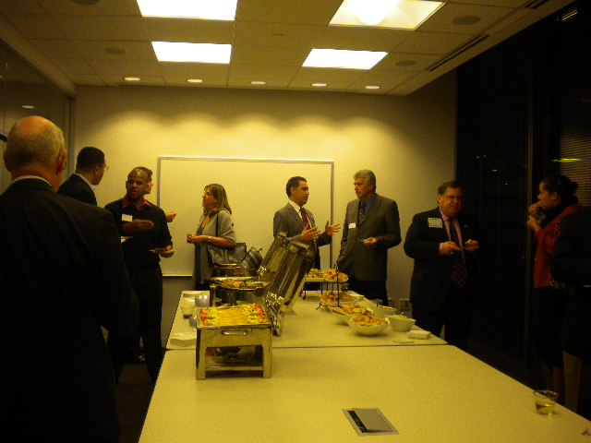

Slide 7
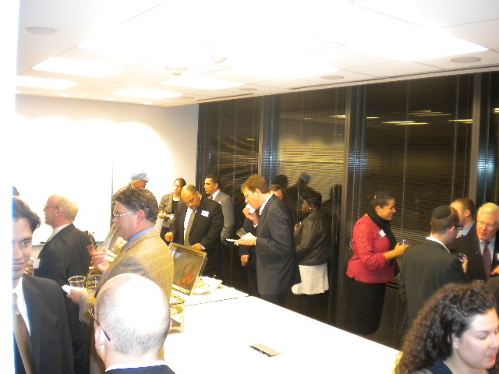

Slide 8


Slide 9
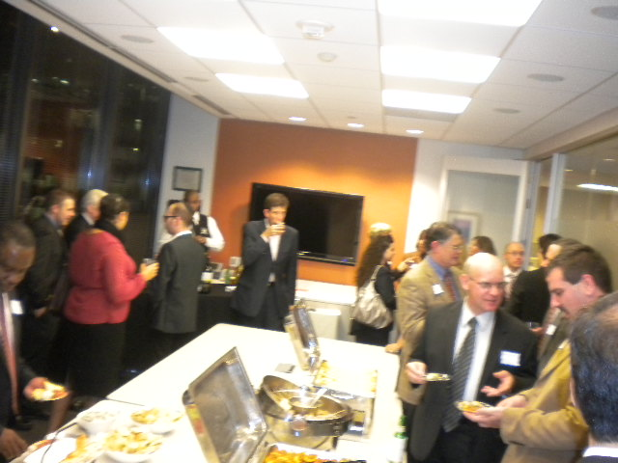

Slide 10
